Slide 1
Key Food Loss and Waste Statistics
August 2024

Slide 2
TABLE OF CONTENTS
1
Key Food Loss and Waste Statistics
Economic, Social & Environmental Impacts
2
Key Definitions & ne’ma Terminology
3

Slide 3
Key Food Loss and Waste Statistics

Slide 4
Global Food Security and Nutrition
FOOD INSECURITY
HUNGER
2.33 billion people, 28.9 % of the global population, were moderately or severely food insecure in 2023
In 2023, between 713 and 757 million people (8.9 to 9.4% of the global population) were undernourished, with a mid-range estimate of 733 million—about 152 million more than in 2019 facing hunger
2.33B
733M
LACK OF ACCESS TO HEALTHY DIETS
CHRONIC
UNDERNOURISHMENT
2.8B
Around 2.8 billion people, which is more than one-third of people in the world, could not afford a healthy diet in 2022, with the largest percentage in low-income countries
582M
582 million people are projected to be chronically undernourished, by 2030, with more than half in Africa
Source: The State of Food Security and Nutrition in the World 2024 (FAO, IFAD, UNICEF, WFP, WHO)

Slide 5
Global Food Loss and Waste
USD 1 trillion
HOUSEHOLD FOOD WASTE IS A GLOBAL PROBLEM
is the estimated cost of both food loss and waste on the global economy
High-income, upper-middle income, and lower-middle income countries differ in average levels of household food waste by only 7 kgs per capita per year
1.05 billion tons of wasted food
is generated, amounting to 132 kgs per capita, and almost one-fifth of all food available to consumers
The bigger divide comes in the variations between urban and rural populations
8-10% of annual GHG emissions
are produced from food loss and waste, almost 5 times that of the aviation sector
FOOD LOSS AND WASTE ACROSS THE SUPPLY CHAIN
As much as 19% of food that reaches the consumption stage is subsequently disposed by retailers, food service and households
13% of food was lost in the supply chain with an approximate economic value of USD 400 billion¹
Source: UNEP Food Waste Index Report 2024 (1) https://sdg12hub.org/sdg-12-hub/see-progress-on-sdg-12-by-target/123-food-loss-waste

Slide 6
Global Food Waste by Sector
In 2022, global food waste across retail, food services, and households reached 1.05 billion tons, with 60% from households, 28% from food services, and 12% from retail. This amounts to 132 kg per capita annually worldwide, with households alone wasting 79 kg per capita, equivalent to 1 billion meals daily.
12%
28%
60%
RETAIL
FOOD SERVICES
HOUSEHOLDS
Figure 1: % of Global Food Waste by Sector
The report estimates that 19% of total global food production may end up as food waste at the retail and consumer stages while 13% of food was lost in the supply chain with an approximate economic value of USD 400 billion¹
Source: UNEP Food Waste Index Report 2024 (1) https://sdg12hub.org/sdg-12-hub/see-progress-on-sdg-12-by-target/123-food-loss-waste

Slide 7
Economic, Social & Environmental Impacts

Slide 8
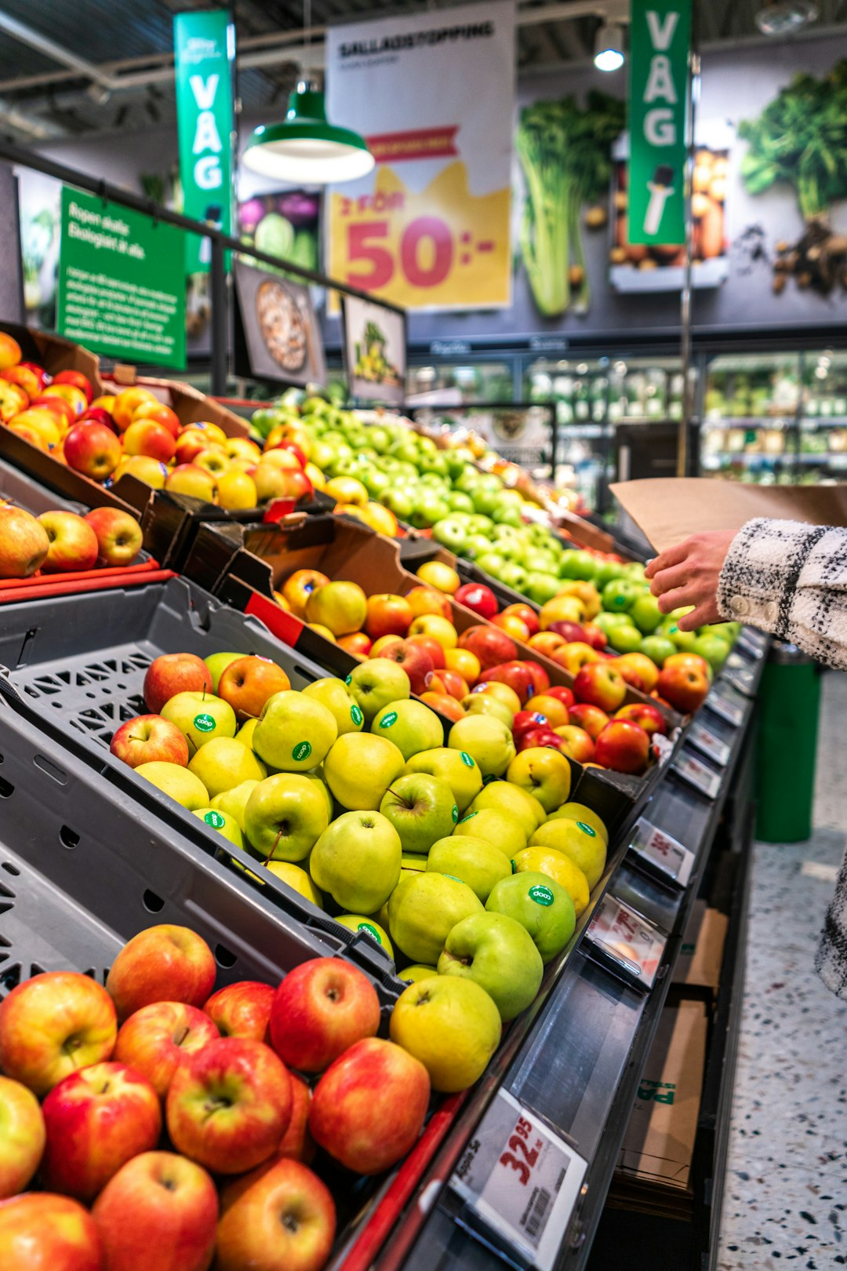
Economic Impact of Food Loss & Waste
Economic Impact of Food Loss & Waste
01
Global Cost of Food Loss & Waste
USD 1 trillion is the estimated cost of both food loss and waste on the global economy¹
02
Inability to Afford Healthy Diet
Around 2.8 billion people, (over a third of the global population) could not afford a healthy diet in 2022, with the largest % in low-income countries²
03
Global Economic Loss from Post-Harvest Food Waste
Globally, at least USD 400 billion³ is lost due to 13% of food being wasted after harvest, including during transport, storage, and processing¹
04
Global Food Waste on Farms
Food waste is a market failure that results in the throwing away of more than USD 1 trillion worth of food every year¹
Globally, USD 370 million worth of food is wasted on farms each year, according to a 2021 report by WWF-UK and Tesco⁴
Source: (1) UNEP Food Waste Index Report 2024 (2) The State of Food Security and Nutrition in the World 2024 (FAO, IFAD, UNICEF, WFP, WHO) (3) https://sdg12hub.org/sdg-12-hub/see-progress-on-sdg-12-by-target/123-food-loss-waste (4) https://wwfint.awsassets.panda.org/downloads/wwf_uk__driven_to_waste___the_global_impact_of_food_loss_and_waste_on_farms.pdf

Slide 9
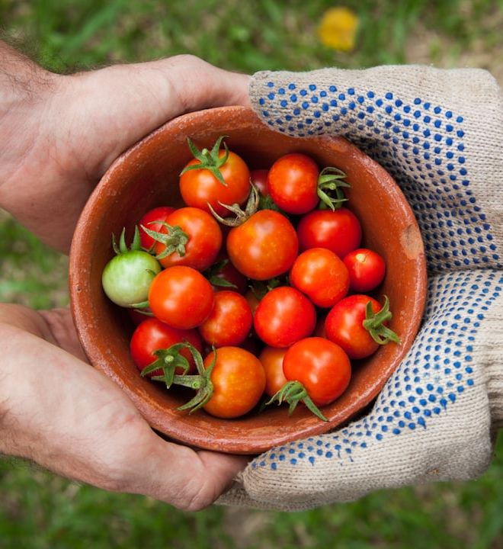
Social Impact of Food Loss & Waste
Social Impact of Food Loss & Waste
01
Global Food Waste vs Global Hunger
1.05 billion tons of wasted food is generated, amounting to 132 kgs per capita¹ whilst at the same time around 733 million people were affected by hunger²
02
Global population expected to grow to 10 billion by 2050
Population growth will drive food demand. Without reducing FLW, the amount of FLW is projected to double as the food system expands to meet demand³
03
Global Food Insecurity
In 2023, 2.33 billion people (28.9% of the global population) faced moderate or severe food insecurity. In 2022, over 2.8 billion people couldn't afford a healthy diet, with the highest rates in low-income countries²
04
Global Hunger and Chronic Undernourishment
With the global population expected to hit 10 billion by 2050³, almost a third of humanity faces food insecurity², yet a fifth of all food is still wasted⁴
In 2023, 713 to 757 million people globally were undernourished, with a mid-range estimate of 733 million. By 2030, 582 million people are projected to be chronically undernourished, with over half in Africa²
Source: (1) UNEP Food Waste Index Report 2024 (2) The State of Food Security and Nutrition in the World 2024 (FAO, IFAD, UNICEF, WFP, WHO) (3) Goodwin, L. (2023, April). The Global Benefits of Reducing Food Loss and Waste, and How to Do It. World Resources Institute. https://www.wri.org/ insights/reducing-food-loss-and-food-waste (4) https://news.un.org/en/story/2024/03/1148036

Slide 10
Environmental Impact of Food Loss & Waste
Environmental Impact of Food Loss & Waste
01
Global Greenhouse Gas (GHG) Emissions
8 to 10% of global GHGs are produced from food loss and waste. If food waste were a country, it would be the 3rd largest GHG emitter after US and China¹
02
Methane Hotspot
Food in landfills produces large amounts of methane which is 25 times more potent than CO2 and a driver of the climate crisis²
03
Higher Food Waste in Hotter Countries
This occurs at both the household level and post-harvest stages due to high temperatures impacting storage, processing, and transportation³
04
Agricultural Land Use in Global Food Production
Food systems puts pressure on 86% of the world’s threatened species, yet land area the size of China is used to grow food that is lost or wasted⁴
More than one-third of all the food that is produced globally, uses over a quarter (28%) of the world’s agricultural area³
Source: (1) FAO - Food Wastage Footprint 2015 (2) https://www.fao.org/newsroom/detail/mapping-ways-to-reduce-methane-emissions-from-livestock-and-rice/en (3) UNEP Food Waste Index Report 2024 (4) https://refed.org/uploads/reducing-food-loss-and-waste-a-roadmap-for-philanthropy.pdf

Slide 11
Key Definitions & ne’ma Terminology

Slide 12
FAO/UNEP Definitions
Term | UNEP/FAO Definition
Food loss and waste | Food loss and waste (FLW) refers to a decrease, at all stages of the food chain from harvest to consumption in mass, of food that was originally intended for human consumption, regardless of the cause¹
Food loss | Food losses (FL) refers to a decrease, at all stages of the food chain prior to the consumer level, in mass, of food that was originally intended for human consumption, regardless of the cause¹
Food waste | Food waste (FW) refers to food appropriate for human consumption being discarded or left to spoil at consumer level – regardless of the cause¹
Food system | A food system gathers all the elements (environment, people, inputs, processes, infrastructures, institutions, etc.) and activities that relate to the production, processing, distribution, preparation and consumption of food, and the outputs of these activities, including socio-economic and environmental outcomes¹
Sustainable food system | A sustainable food system (SFS) is a food system that ensures food security and nutrition for all in such a way that the economic, social and environmental bases to generate food security and nutrition of future generations are not compromised¹
Food security | Physical, social and economic access by all people at all times to sufficient, safe and nutritious food needed for a healthy and active life²
Food insecurity | A situation that exists when people lack secure access to sufficient amounts of safe and nutritious food for normal growth and development and an active and healthy life²
Food value chain | It consists of all the stakeholders who participate in the coordinated production and value-adding activities that are needed to make food products²
Edible Waste | Edible waste encompasses food that is discarded or wasted but is still suitable for human consumption. This includes leftovers from meals, expired but still edible food items, and produce with minor cosmetic imperfections. Edible waste is essentially food that could have been consumed but is instead thrown away.
Inedible Waste | Inedible waste refers to food or food-related materials that are not suitable for human consumption and cannot be used for other purposes. This includes items such as food scraps, bones, shells, and peels, as well as packaging materials like plastic wrappers and containers. Inedible waste cannot be salvaged or repurposed for human consumption and is typically destined for disposal.
Notes:
Sources:
https://openknowledge.fao.org/server/api/core/bitstreams/b1949fae-23d4-473c-8b87-8c4359b74d6c/content
https://www.ifad.org/documents/38714170/45319622/nutrition_glossary.pdf/4dd5c563-ba62-1dbd-26de-e1289805740f?t=1649852465109

Slide 13
Key Terms Simplified
Term | Definition
Food loss | Food that is lost before reaching the consumer due to poor harvesting, insufficient packaging, or problems with transportation and storage.
Food waste | Food thrown away rather than consumed by retailers, food services, or consumers due to over-purchasing, spoilage, and surplus production.
Overproduction | The excessive production of food beyond what is demanded or needed by customers. Overproduction is driven by the attempt to meet perceived customer demand, making it a serious issue in the food industry¹.
Overconsumption | The excessive consumption of food beyond what is necessary or required. Overconsumption also refers to consumer purchasing habits, with many people buying more food than they can consume¹.
Surplus Food | Surplus food refers to food that is still safe and edible but is in excess of what is needed or consumed. This can occur at various stages of the food supply chain, including production, distribution, retail, or consumption. Surplus food often results from overproduction, market fluctuations, or aesthetic imperfections but is still fit for consumption.
Rescued Food | Rescued food is surplus food that is recovered or diverted from being wasted and redistributed to those in need. This can involve collecting excess food from farms, manufacturers, retailers, or food service establishments and redistributing it to food banks, shelters, charities, or community organizations. Rescued food helps to alleviate hunger, reduce food waste, and support vulnerable populations.
Diverting from Landfill | Diverting food from landfill refers to the practice of redirecting food waste away from disposal in landfills or incineration facilities. Instead of being discarded, food waste is diverted to alternative disposal methods such as composting, anaerobic digestion, or food recycling programs. This helps to reduce the environmental impact of food waste by minimizing methane emissions from landfills and conserving valuable resources.
SOURCE REDUCTION
FEED HUNGRY PEOPLE
FEED ANIMALS
INDUSTRIAL USES
COMPOSITING
LANDFILLS /
INCINERATION
Last resort
Notes:
Sources
https://shapiroe.com/blog/overconsumption-overproduction-food-waste/#Defining_Overconsumption_and_Overproduction
https://sor.epa.gov/sor_internet/registry/termreg/searchandretrieve/termsandacronyms/search.do?search=&term=carbon%20dioxide%20equivalent&matchCriteria=Contains&checkedAcronym=true&checkedTerm=true&hasDefinitions=false
https://www.epa.gov/ghgemissions/overview-greenhouse-gases
https://static1.squarespace.com/static/64ca0dc9148bc5446708bedb/t/65e1dea79111a02895bed89c/1709301427929/Somamater-WP-Global-Food-Waste-Policies.pdf

Slide 14
ne’ma Terminology
 | Guidelines
Referencing ne’ma | When introducing ne’ma, the full title should be used: ne’ma - The National Food Loss and Waste Initiative
Branding titles | When referencing ne’ma’s tools, use the following full titles ne’ma National Data Hub Recognition certificates ne’ma pledge
Publications | The National Food Loss and Waste Initiative Roadmap - 2023 How to reduce food waste using three low-cost nudges | A practical guide for canteens and buffet restaurants - 2023 How the UAE Eats | Findings from the UAE’s First National Household Food Waste Survey - 2023 National Action at Scale for Reducing Food Waste in the Hospitality Sector – 2023 ne’ma roadmap ne’ma impact report foundation years
Differentiation between Projects, Programs and Activations | When referencing the projects, kindly use these correct titles: The National Baseline Study International Missions and Collaborations LSE Food Loss and Waste Policy Study ne’ma Stars Rating System for Hospitality | When referencing the programs, kindly use these correct titles: ne’ma Food Rescue Program ne’ma Educational Program ne’ma Behavioral Lab (Sectorial Activations: Hospitality, Households) Advocacy Awareness Program (tbc w/team) | Avoid using the word initiatives. Instead use the word activation
Notes:
Sources
https://shapiroe.com/blog/overconsumption-overproduction-food-waste/#Defining_Overconsumption_and_Overproduction
https://sor.epa.gov/sor_internet/registry/termreg/searchandretrieve/termsandacronyms/search.do?search=&term=carbon%20dioxide%20equivalent&matchCriteria=Contains&checkedAcronym=true&checkedTerm=true&hasDefinitions=false
https://www.epa.gov/ghgemissions/overview-greenhouse-gases
https://static1.squarespace.com/static/64ca0dc9148bc5446708bedb/t/65e1dea79111a02895bed89c/1709301427929/Somamater-WP-Global-Food-Waste-Policies.pdf

Slide 15
ne’ma Impact Metrics
IMPACT METRICS
Environment
Number of kg of food waste diverted from landfill
Number of kg of CO2e emissions prevented
kg of compost created for nourishing the local farmland
People
# meals donated and redistributed through surpluses
# volunteering hours
# of meals distributed from food surplus through smart community fridges
# of boxes distributed
Local economy
AED of economic value created through empowered innovation
Carbon dioxide equivalent (CO2e) is the number of metric tons of CO2 emissions with the same global warming potential as one metric ton of another GHG (EPA)2
Greenhouse Gas (GHG) Emissions: Gases that trap heat in the atmosphere are called greenhouse gases including carbon dioxide (CO2), methane (CH4), nitrous oxide (N2O) and fluorinated gases (EPA)2.
Notes:
Sources
https://shapiroe.com/blog/overconsumption-overproduction-food-waste/#Defining_Overconsumption_and_Overproduction
https://sor.epa.gov/sor_internet/registry/termreg/searchandretrieve/termsandacronyms/search.do?search=&term=carbon%20dioxide%20equivalent&matchCriteria=Contains&checkedAcronym=true&checkedTerm=true&hasDefinitions=false
https://www.epa.gov/ghgemissions/overview-greenhouse-gases
https://static1.squarespace.com/static/64ca0dc9148bc5446708bedb/t/65e1dea79111a02895bed89c/1709301427929/Somamater-WP-Global-Food-Waste-Policies.pdf

Slide 16
Summary: UNEP’s Food Waste Index Report 2024
USD 1 trillion
FOOD LOSS AND WASTE IS A GLOBAL PROBLEM
is the estimated cost of both food loss and waste on the global economy
High-income, upper-middle income, and lower-middle income countries differ in average levels of household food waste by only 7 kgs per capita per year
1.05 billion tons of wasted food
is generated, amounting to 132 kgs per capita, and almost one-fifth of all food available to consumers
The bigger divide comes in the variations between urban and rural populations
8-10% of annual GHG emissions
are produced from food loss and waste, almost 5 times that of the aviation sector
~19% of food reaching the consumption stage is disposed by food services, retailers & households
12%
28%
60%
of global food waste comes from the
of global food waste comes from
of global food waste comes from
RETAIL SECTOR
FOOD SERVICES​
HOUSEHOLDS​
Notes:
Source: UNEP Food Waste Index Report https://wedocs.unep.org/handle/20.500.11822/45230 The UNEP Food Waste Index Report 2024, co-authored with WRAP, provides the most accurate global estimate on food waste at retail and consumer levels. It provides guidance for countries on improving data collection and suggests best practices in moving from measuring to reducing food waste.
2022: The world wasted an estimated 1.05 billion tonnes of food in the retail, food service and household sectors combined

Slide 17
Visualise the KPIS and add def footnotes
ne’ma impact metrics
Impact metrics
Environmental
KPIs | Number of kg of food waste diverted from landfill Number of kg of CO2e emissions prevented Carbon dioxide equivalent (CO2e) is the number of metric tons of CO2 emissions with the same global warming potential as one metric ton of another GHG (EPA)² Greenhouse Gas (GHG) Emissions: Gases that trap heat in the atmosphere are called greenhouse gases including carbon dioxide (CO2), methane (CH4), nitrous oxide (N2O) and fluorinated gases (EPA)².
 | Greenhouse Gas (GHG) Emissions: Gases that trap heat in the atmosphere are called greenhouse gases including carbon dioxide (CO2), methane (CH4), nitrous oxide (N2O) and fluorinated gases (EPA)².
Social
 | Number of meals distributed from surpluses
Economic
Notes:
Sources
https://shapiroe.com/blog/overconsumption-overproduction-food-waste/#Defining_Overconsumption_and_Overproduction
https://sor.epa.gov/sor_internet/registry/termreg/searchandretrieve/termsandacronyms/search.do?search=&term=carbon%20dioxide%20equivalent&matchCriteria=Contains&checkedAcronym=true&checkedTerm=true&hasDefinitions=false
https://www.epa.gov/ghgemissions/overview-greenhouse-gases
https://static1.squarespace.com/static/64ca0dc9148bc5446708bedb/t/65e1dea79111a02895bed89c/1709301427929/Somamater-WP-Global-Food-Waste-Policies.pdf

